Slide 1
Computer ARCHITECTURE (CA)
Course Instructor
Hira beenish
Department of Computer Science

Slide 2


Recommended Books
Computer Systems Architecture, 3rd Edition
By M.Morris Mano; Prentice Hall International
Computer Organization and Architecture Designing For Performance By William Stallings

Slide 3
Chapters Included
1. Digital logic circuits
2. Digital components
3. Data Representation
4. Register transfer
5. Basic Computer Organization & Design →→Mid Term
6. Central processing unit
7.Pilpeline & vector processing
8. Cache memory & virtual memory
9. I/O & O/P organization
10. Memory organization

Slide 4
Cache memory & virtual memory

Slide 5
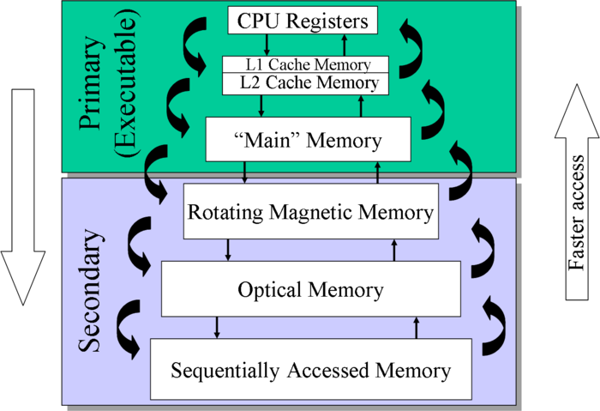

Slide 6
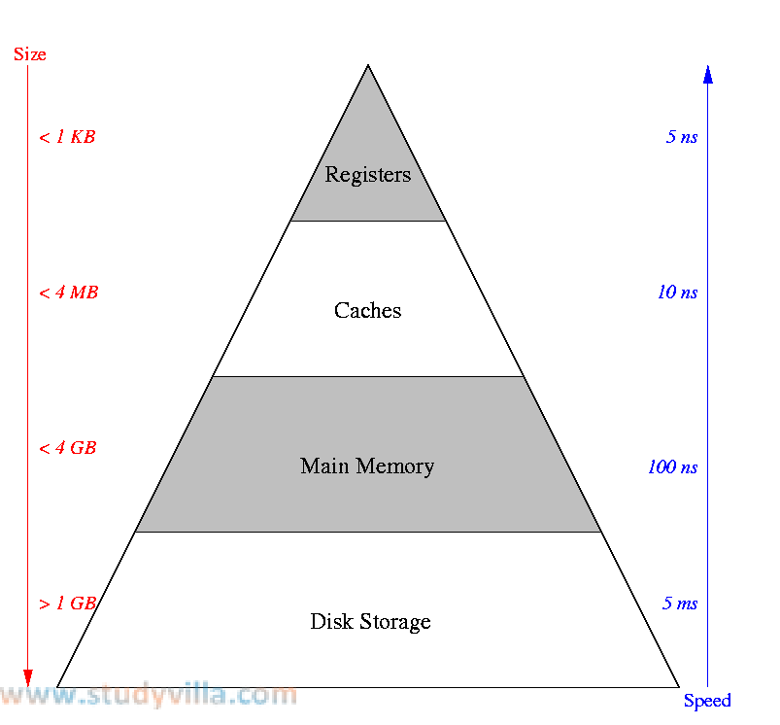

Slide 7
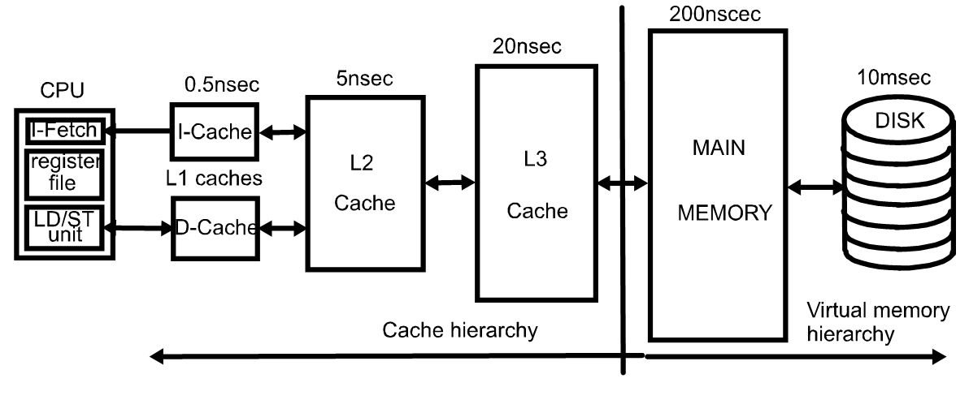
Typical Memory Hierarchy

Slide 8
Cache Memory
To access a particular piece of data, the CPU first sends a request to its nearest memory, usually cache
If the data is not in cache, then main memory is queried. If the data is not in main memory, then the request goes to disk.
Once the data is located, then the data, and a number of its nearby data elements are fetched into cache memory.
Although cache is much smaller than main memory, its access time is a fraction of that of main memory

Slide 9

is the term applied to situations where the same value or related storage locations are frequently accessed
Temporal locality: states that recently accessed items are likely to be accessed in the near future.
Spatial locality: says that items whose addresses are near one another tend to be referenced close together in time.

Slide 10
Basic Definitions
A cache miss
occurs if the cache does not contain the requested data. This is bad, since the CPU must then wait for the slower main memory.
There are two basic measurements of cache performance.
The hit rate is the percentage of memory accesses that are handled by the cache.
The miss rate (1 - hit rate) is the percentage of accesses that must be handled by the main RAM

Slide 11
Cache Memory
The “content” that is addressed in content addressable cache memory is a subset of the bits of a main memory address called a field.
The fields into which a memory address is divided provide a many-to-one mapping between larger main memory and the smaller cache memory.
Many blocks of main memory map to a single block of cache. A tag field in the cache block distinguishes one cached memory block from another.

Slide 12
Cache Memory
The simplest cache mapping scheme is direct mapped cache.
In a direct mapped cache consisting of N blocks of cache, block X of main memory maps to cache block Y = X mod N.
Thus, if we have 10 blocks of cache, block 7 of cache may hold blocks 7, 17, 27, 37, . . . of main memory.
Once a block of memory is copied into its slot in cache, a valid bit is set for the cache block to let the system know that the block contains valid data.

Slide 13
Types/Levels of Cache Memory
A computer can have several different levels of cache memory. the level numbers refers to distance from cpu where level 1 is the closest. all levels of cache memory are faster than ram.
The cache closest to cpu is always faster but generally costs more and stores less data then other level of cache.

Slide 14
Level 1 (L1) Cache
It is also called primary or internal cache. It is built directly into the processor chip. It has small capacity from 8 to 128 Kb.

Slide 15
Level 2 (L2) Cache
it is slower than l1 cache. its storage capacity is more, i-e. from 64 kb to 16 mb. the current processors contain advanced transfer cache on processor chip that is a type of l2 cache. the common size of this cache is from 512 kb to 8 mb

Slide 16
Level 3 (L3) Cache
this cache is separate from processor chip on the motherboard. it exists on the computer that uses l2 advanced transfer cache. it is slower than l1 and l2 cache. the personal computer often has up to 8 MB of l3 cache.

Slide 17
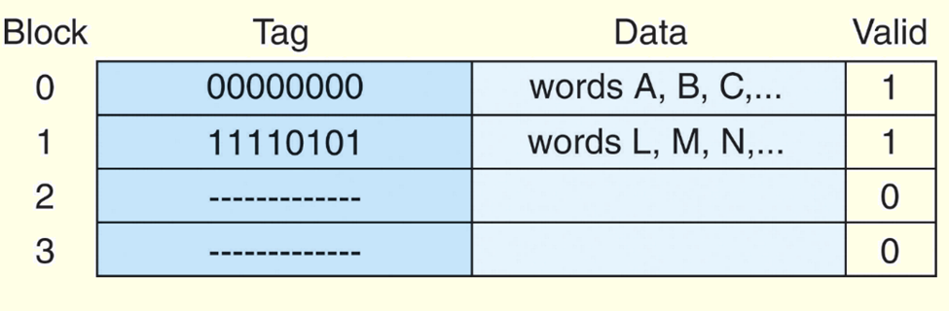
Cache Memory
The diagram below is a schematic of what cache looks like.
Block 0 contains multiple words from main memory, identified with the tag 00000000. Block 1 contains words identified with the tag 11110101.
The other two blocks are not valid.

Slide 18
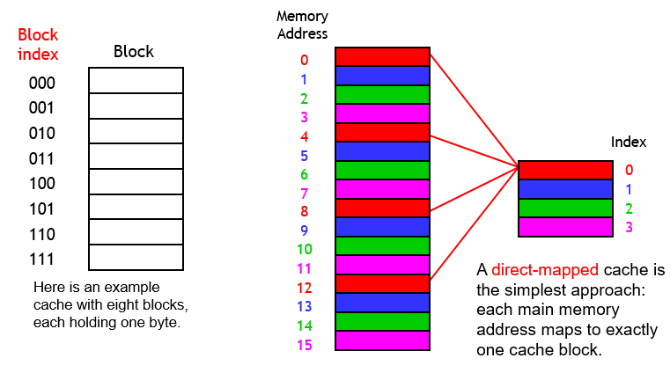
A simple cache design
caches are divided into blocks, which may be of various size the number of blocks in a cache is usually a power of 2.

Slide 19
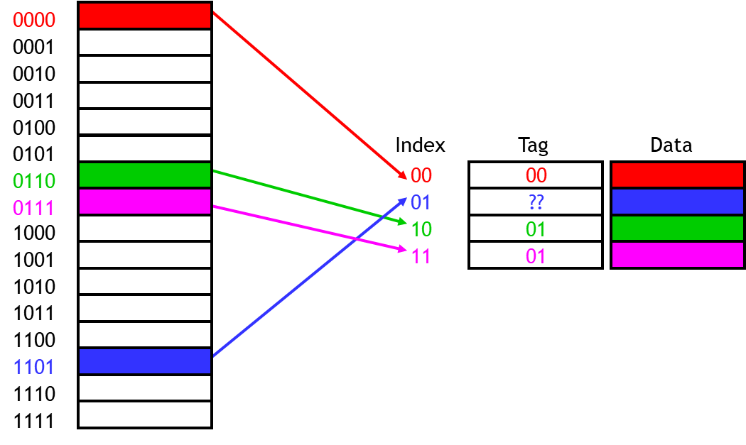
Adding tags
We need to add tags to the cache, which supply the rest of the address bits to let us distinguish between different memory locations that map to the same cache block

Slide 20
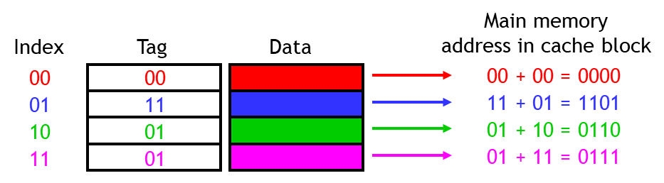
Figuring out what’s in the cache
Now we can tell exactly which addresses of main memory are stored in the cache, by concatenating the cache block tags with the block indices

Slide 21
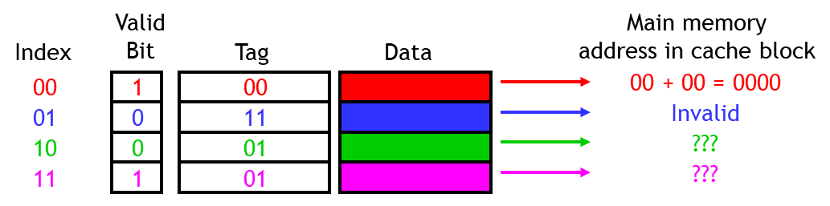
One more detail: the valid bit
When started, the cache is empty and does not contain valid data.
We should account for this by adding a valid bit for each cache block.
When the system is initialized, all the valid bits are set to 0.
When data is loaded into a particular cache block, the corresponding valid bit is set to 1.

Slide 22
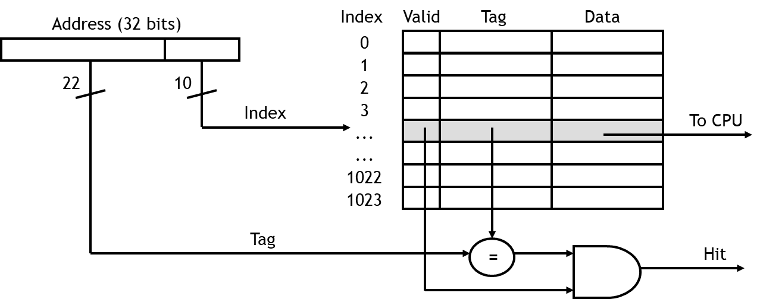
What happens on a cache hit
When the CPU tries to read from memory, the address will be sent to a cache controller.
The lowest k bits of the block address will index a block in the cache.
If the block is valid and the tag matches the upper (m - k) bits of the m-bit address, then that data will be sent to the CPU.
Here is a diagram of a 32-bit memory address and a 2¹⁰-byte cache.

Slide 23
What happens on a cache miss
On cache hit, CPU proceeds normally
On cache miss
Stall the CPU pipeline
Fetch block from next level of hierarchy
Instruction cache miss
Restart instruction fetch
Data cache miss
Complete data access
The delays that we have been assuming for memories (e.g., 2ns) are really assuming cache hits.

Slide 24
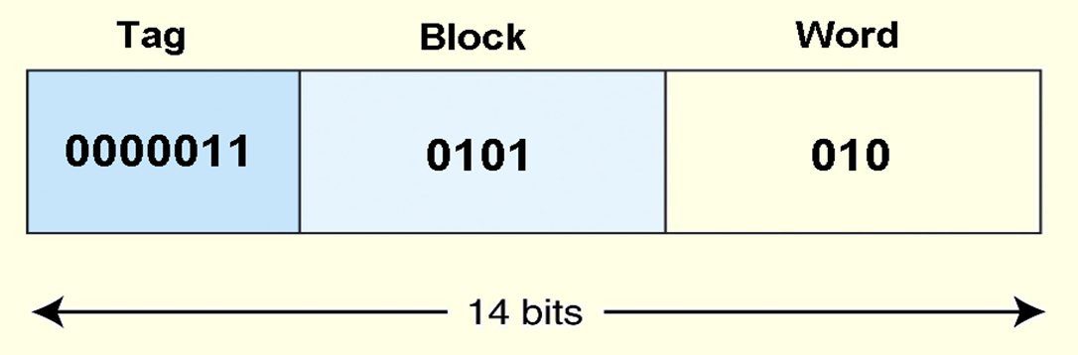
Cache Memory
As an example, suppose a program generates the address 1AA. In 14-bit binary, this number is: 00000110101010.
The first 7 bits of this address go in the tag field, the next 4 bits go in the block field, and the final 3 bits indicate the word within the block.

